Slide 1

Medcurity Network Inventory
Brandon Huyck; Colleen Lemak;
Artis Nateephaisan; Jack Nealon
Notes:
Increase font size
Decrease words on slides

Slide 2
Project Overview
Network Inventory Tool
Goal of tool and risk assessment is to keep HIPAA data of patient protected
Inventory catalog of software and devices
HIPAA requirement
Clients execute and return the report to Medcurity
Used in client onboarding before Medcurity can provide their risk assessment
Stand-alone: tool is not integrated into existing Medcurity software
Notes:
Brandon
High level overview of the problem statement
What were you asked to implement?
Describe the main features, limitations, and assumptions

Slide 3
Project Requirements
Search the entire network for target devices and software
Collect, store, filter, and display the data
Communicate with user its progress and results
Save and export information to review later and share with Medcurity
Notes:
Brandon

Slide 4
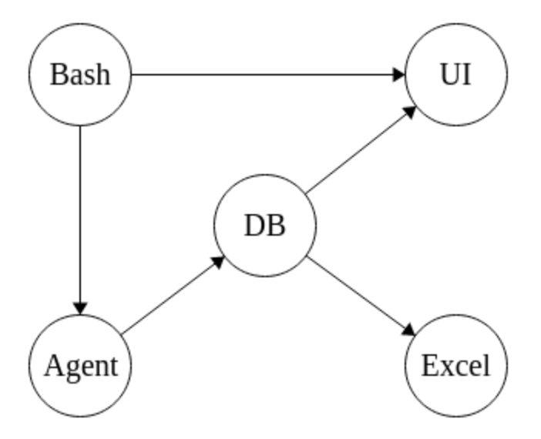



Project Solution Approach
Network Crawler Agent
Cloud Database
MySQL
MariaDB
AWS
Local Graphical User Interface (GUI)
Progress, results, editing
Bash, Excel, Testing, Documentation
Notes:
Brandon

Slide 5

Testing, Validation, and Acceptance Plan
Tests
Unit tests
Integration tests
User tests
How will we know our project is deliverable?
Notes:
Unit Tests:
We plan on using unit tests throughout our code to ensure that any potential small issues get caught and resolved early
Integration Tests:
Whenever applicable, we want to be able to test different components of our project, especially how they interact with each other
Will be used a lot as major segments of the software system start working
User Tests:
After the project is done and can be run, we want to be able to have users, whether it be our advisor, sponsor, classmates, test it so the team can take notes, observe, and ask for feedback
Deliverable?:
When all of our tests are accounted for and the base functionality of the product fit what the sponsors are looking for, we will consider our project deliverable

Slide 6



Major work accomplished so far
What’s been done so far?
Weekly meetings
Individual and Group research into:
Crawler Agents
Database systems
Existing UI formatting
Design Layouts
491 Class Documents
Design Choices
Git and Github mySQL
MariaDB PHP
AWS Zipline
Testing and CI/CD
Testing made during development
Testing Team Cover Gaps
CI/CD created alongside development.

Slide 7
Milestones and Project Release Plan
Database Design | December 4th
Crawler Agent Outline
Testing Approach Plan
User Interface Layout
Database Version 0 | March 11th
Crawler Agent Version 0
User Interface Version 0
Optimization and Debugging Due | April 22th
Deliver the project | May 3rd
Deploy to client(s)

Slide 8
Project Sprints
10/24-11/6 | 1/30 - 2/12
11/7 - 11/ 20 | 2/13 - 2/26
11/27 - 12/4 - Post Thanksgiving | 2/27 - 3/10 - Version 0 Complete
12/5 - 12/18 - Layouts + Outlines Done | 3/18 - 3/25 - Post Spring Break
12/19 - 1/1 - Winter Break | 3/26 - 4/8
1/2 - 1/15 - Winter Break | 4/9 - 4/22 - Debug and Optimize Done
1/16 - 1/29 | 4/23 - 5/3 - Delivery and Deployment

Slide 9


Maintenance Considerations
How will the project be packaged?
Zip file
How will the project be delivered?
GitHub
How will your project be deployed?
Communicating with sponsors
Project maintenance?
Handoff
Notes:
How will your project be packaged?:
All files will be compressed into a zip file
How will your project be delivered?:
Delivered through access to our GitHub repo with all the files, where they will then be able to pull all the files
How will your project be deployed?:
Give our sponsors a thorough rundown of how the project works, show all documentation, provide any clarifying details
Who will be maintaining the project and under what conditions?:
Hopefully, with our thorough documentation, we will be able to hand the product off to Medcurity and their IT department will understand each component of the project in detail and be able to handle it

Slide 10
Project Risks and Strategies
Data corruption
Data loss : back-up files
Database performance
Poor performance (Zipline) : update DB & OS
Data security breach
Expected entries : encrypt data
Software compatibility
Proper integration : test tools early/often
Sponsor availability
Lack of information : seek another technical member
Notes:
Where are the most likely risks
How will you be taking steps to identify if those risks are going to be a problem
How will you be taking steps to avoid known risks
Testing libraries/3rd party tools early and often is a big one here
Data Corruption
Check for inaccuracies, data loss, and unexpected program crashes
Implement backup procedures, regular database maintenance, and secure authentication
Declining DB performance
Test for poor performance or slow data retrieval with large datasets
Update software interacting with DB and OS
Data security breach
Validate spreadsheet file is populated and generated with expected rows and columns
Test and implement third-party tools early and often to verify usability to project scope
Encrypt data

Slide 11



Project Management Considerations
and Team Collaboration Approaches
What approaches has your team agreed to use for running the project?
Planned meetings
Team collaboration
Communication
Discord Email Texting
How will the project work be broken up? Who is taking lead for what?
GitHub Issues
Notes:
What approaches has your team agreed to use for running the project:
We plan to have two meetings weekly, one which includes the main development team, advisor, dab members, sponsors, to discuss progress updates, clarifying questions, etc
And the second meeting will include just the main development team and we will work on planning deadlines, discussing methodology, etc
The SCRUM meeting leads will be alternated between team members
The meeting leaders will also assign Github issues and cards as necessary
Let us know how your team will be collaborating to make this happen:
We will primarily be using email and Discord messaging
Communicate frequently and ensure everyone is on the same page in terms of due dates and expectations
We will likely be coding separately but if a situation should arise where we need to meet up for an in-person coding session we can arrange that
How will the project work be broken up? Who is taking lead for what:
We plan on having issues and cards created by the team. Tasks will be assigned to members based on their strengths and interests

Slide 12
Budget Plans
Within project scope, our tool may require:
AWS Server to host testing and implementation
Network and devices for testing
Professional license for a network crawler
Future tool maintenance and database upkeep

Slide 13
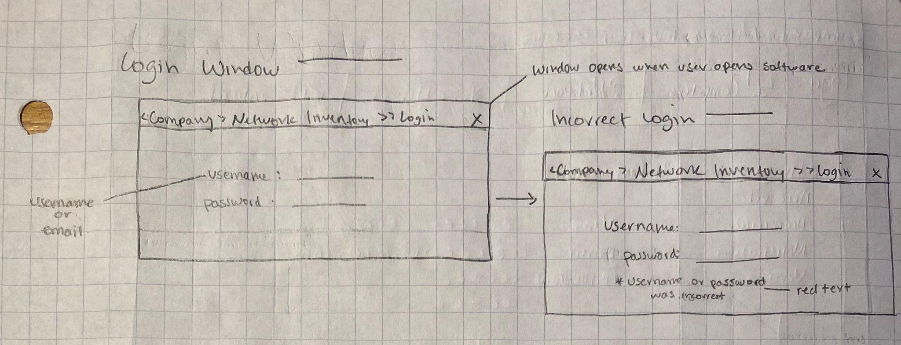
UI Sketches
Login Window

Slide 14
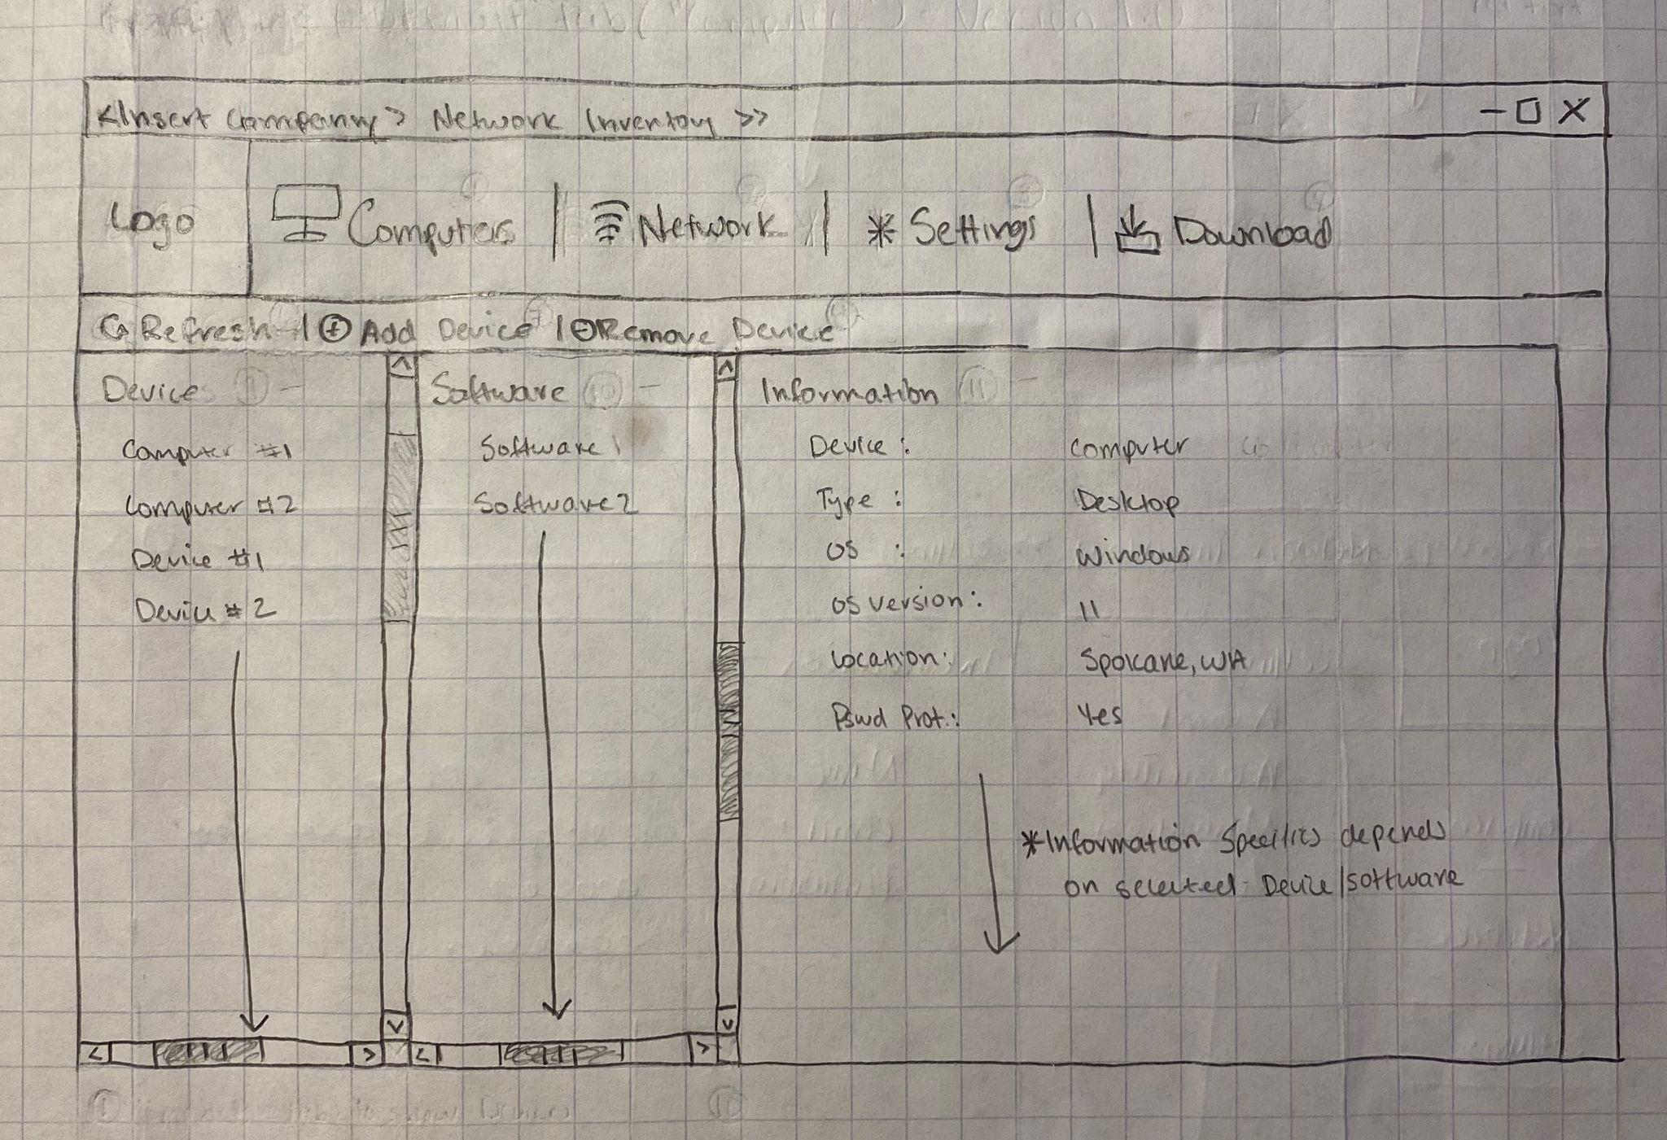
UI Sketches
Homepage v1
Computers Tab

Slide 15
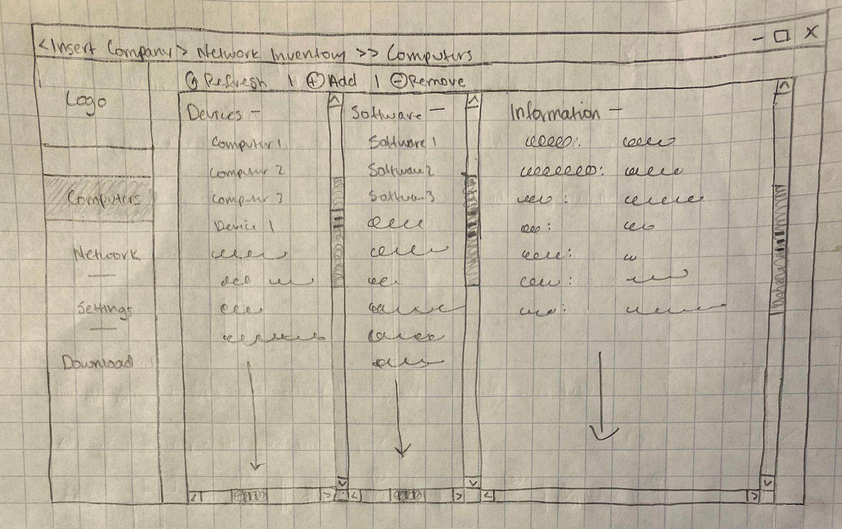
UI Sketches
Homepage v2
Computers Tab

Slide 16
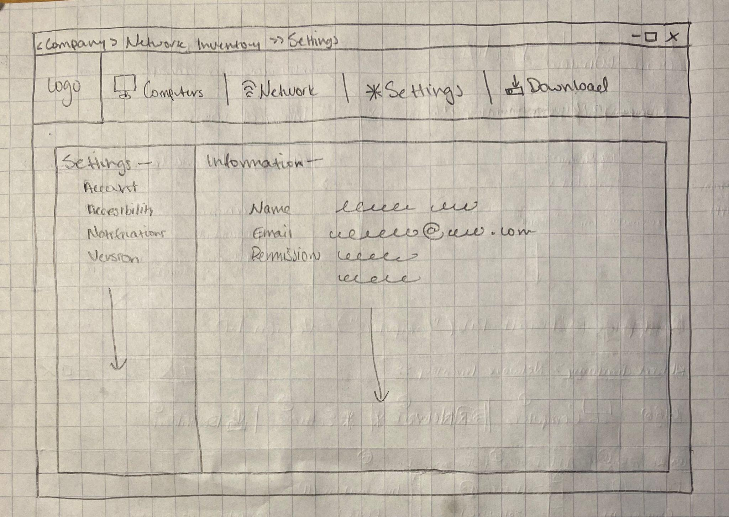
UI Sketches
Settings Tab V1

Slide 17
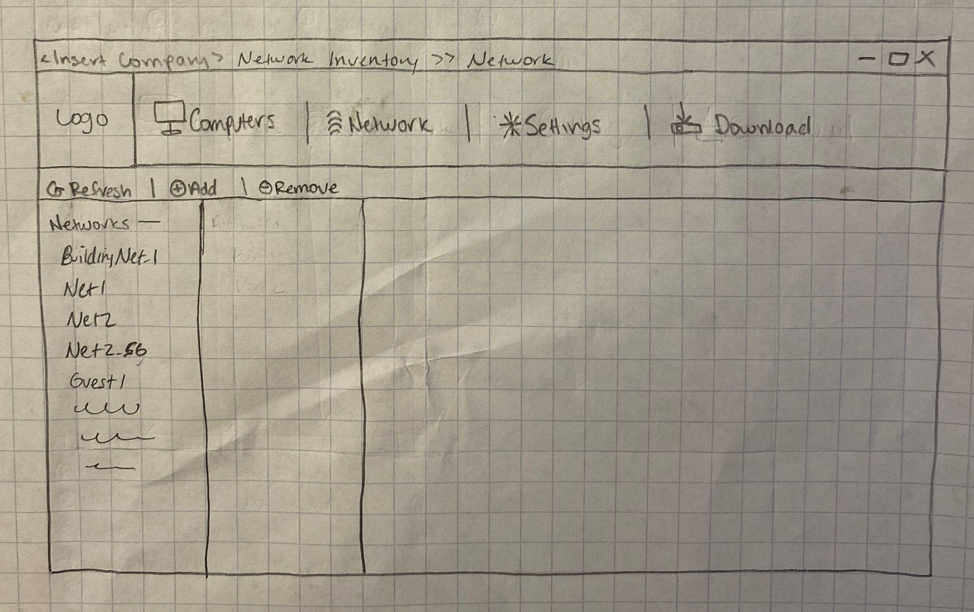
UI Sketches
Networks Tab V1

Slide 18
Summary
Design a user-interface which implements a network scanner to retrieve client data and store results in a database.
Export results as a spreadsheet file to be used by technicians and professionals in Medcurity for easy filtering readability.
Facilitate risk assessment to protect patient HIPAA data and assist professionals in diagnosing security vulnerabilities
Notes:
This is a short presentation (target is 15 minutes + 5-8 mins in questions)
I’d focus on what business objectives you’re being asked to solve, summarize how your work will fit in with the needs of your sponsor, and how your solution is going to achieve their needs

